Slide 1
CASE STUDY ON SOA IN BANKING system
PRESENTED BY DOLLY KUMARI

Slide 2
INTRODUCTION OF SOA
Service-Oriented Architecture (SOA) is a stage in the evolution of application development and/or integration. It defines a way to make SOA allows users to combine a large number of facilities from existing services to form applications.
SOA encompasses a set of design principles that structure system development and provide means for integrating components into a coherent and decentralized system.
SOA-based computing packages functionalities into a set of interoperable services, which can be integrated into different software systems belonging to separate business domains.
Software components reusable using the interfaces.

Slide 3
Major objectives of SOA
There are three major objectives of SOA, each of which focuses on a different part of the application lifecycle:
Service. This objective aims to structure procedures or software components as services. Services are designed to be loosely coupled to applications, so they're only used when needed.
Publishing. SOA also aims to provide a mechanism for publishing available services that include their functionality and input/output requirements.
Security. The third objective of SOA is to control the use of services to avoid security and governance problems.

Slide 4
CASE STUDY ON SOA IN BANKING
Banking systems responsible for account management and periodic operational processing. Many banks have implemented various channels to allow customers to interact via different communication media (ATM, Branch, Internet, Phone Banking, Call Center).
The processes reside in the application silos; heavy data synchronization and replication is required. Many processes are batch driven.
Service Oriented Architecture can offer in this situation is supporting the development of a true multi-channel architecture by re-using channel-agnostic services and allowing process execution transparently across various channels leading to a rather real-time environment.

Slide 5
HOW SOA COULD BENEFIT BANKING INDUSTRY
To be successful in Banking, the Banking Industry needs to be customer-centric. Becoming more customer-centric requires banks to focus on four key areas:
Customer Information Management
Operational Excellence
Intelligent Inbound Cross-Selling

Slide 6
Customer Information Management
Bank wants an easy way to access customer, product, and account information spread across all lines-of-business.
Deploying SOA, where customer data can be consolidated and integrated across the different product silos, can provide a single, comprehensive real-time view of a customer’s relationship with the bank. By connecting backend legacy system to front-end delivery channels, an SOA enables customer data to be made available in real-time at all the bank’s touch points- ATMs, online banking, call centers and retail branches- so that the bank is able to provide accurate, personalized service based on a complete relationship profile.

Slide 7
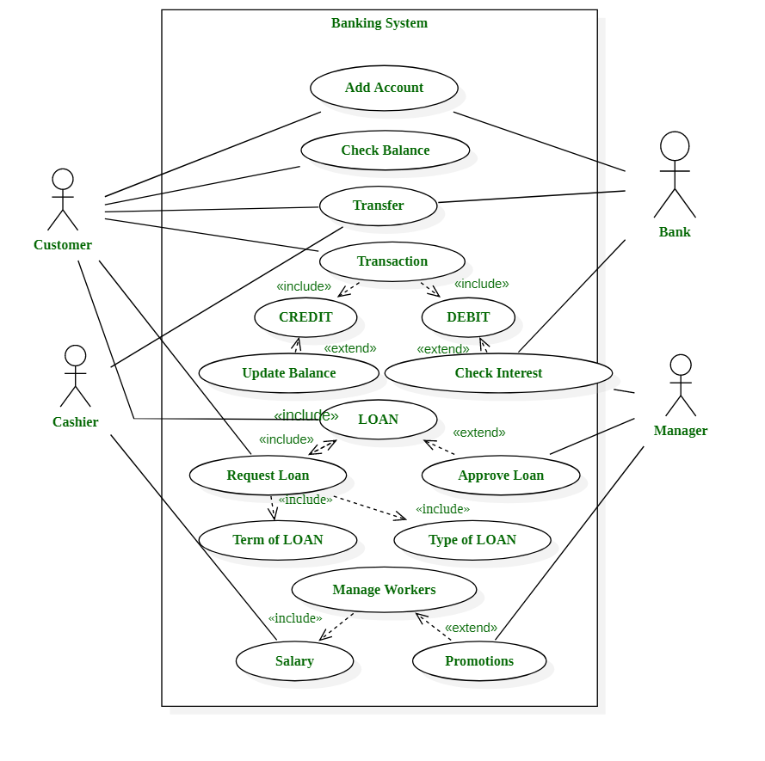
USE CASE OF BANKING SYSTEM

Slide 8
SOA PERFORMANCE TESTING CHALLENGES
Find candidates with the right skill sets who possess in-depth knowledge of involved platforms, applications, databases, and any middleware.
Predicting the future usage of services to assist with performance, load, stress, scalability.
Test strategy differs from traditional testing and generally has to encompass many internal political factors e.g. ownership and responsibility.

Slide 9
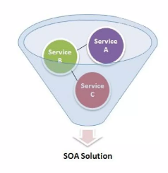
OVERCOMING CHALLENGES
To simplify performance testing for SOA applications break them down into the smallest components:

Slide 10
thankyou

